Slide 1

Texas Motorcycle Safety Coalition
Quarterly Meeting
Thursday, December 12, 2024
10:00 am – noon

Slide 2
Agenda
Welcome
Opening Remarks, Introductions, & Announcements
Guest Speaker: Mona Lisa Fischer, TxDOT San Angelo District TSS
Task Force Update
Update on other motorcyclist safety initiatives/activities
2024 Texas Motorcyclist Safety Forum
Open Forum
Adjourn
Notes:
10:00 – 10:20 AM
Opening Remarks & Introductions (Maurice Maness)
Welcome
Announcements
10:20 – 10:40 AM
Guest Speaker: Mona Lisa Fischer, San Angelo District TSS
10:40 – 11:50 AM
Task Force Update
Task Force project for 2025
Legislation session 2025
10:50 – 11:00 AM
Legislative Update – Matt Ruszczak
11:00 – 11:10 AM
Updates on other motorcyclist safety activities & initiatives
11:10 – 11:45 AM
2024 Texas Motorcyclist Safety Forum
11:45 AM – Noon
Open Forum (open)
What events or efforts are happening in your area?
What topic would you like to hear about next meeting?
Noon
Adjourn (Maurice Maness)

Slide 3
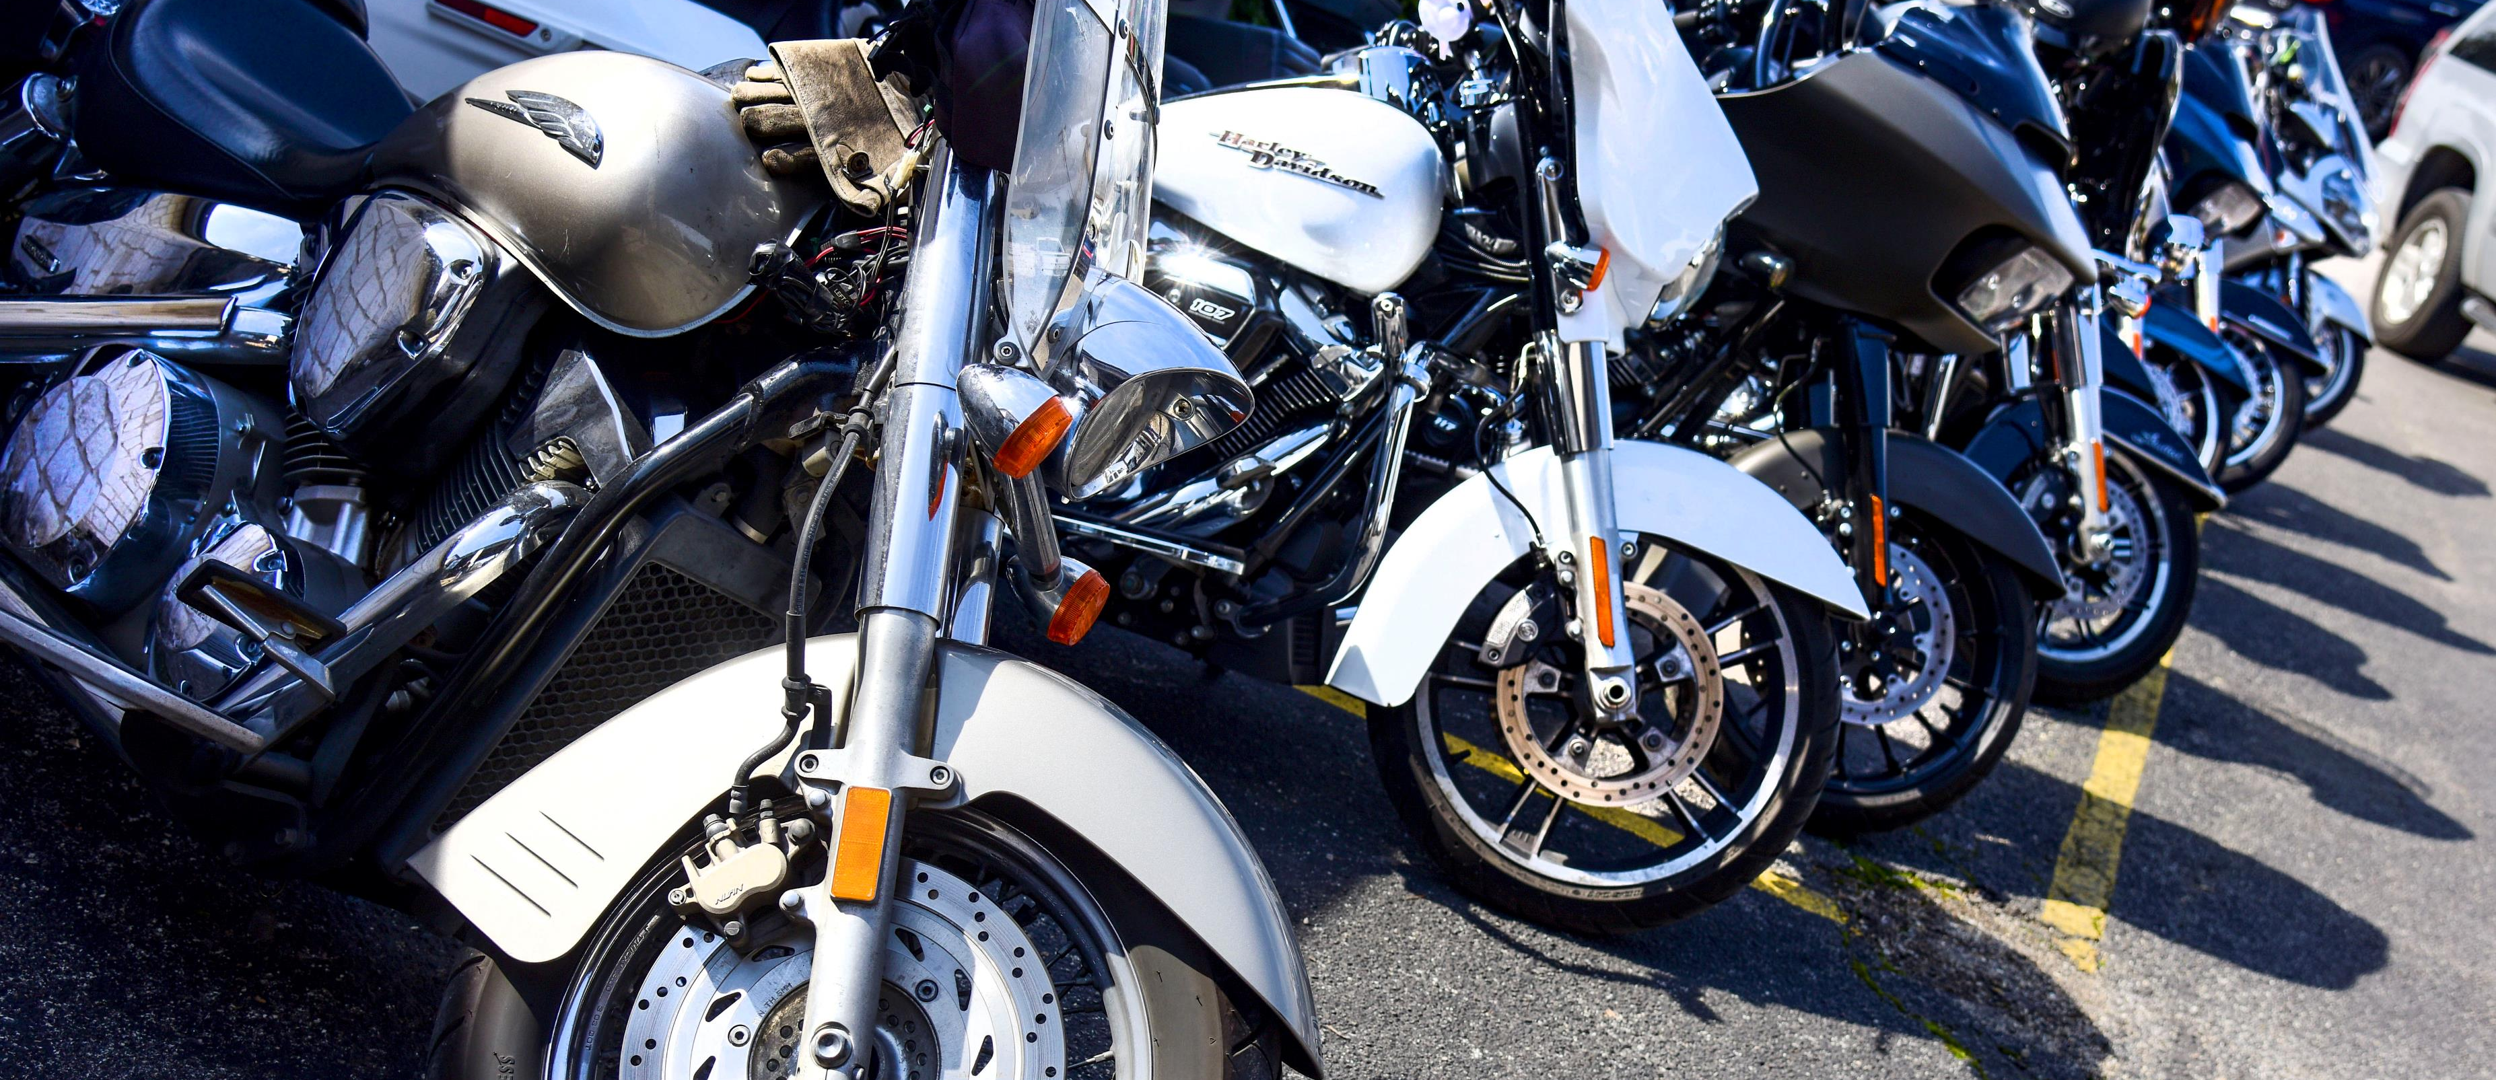
Welcome & Introductions

Slide 4
Announcements
2025 Motorcyclist Safety Awards nominations close end of February
Next TMSC meeting – March
TxDOT Roadway Design Manual November 2024, Chapter 20 (Motorcyclist Design Consideration)
Notes:
Next TMSC meeting in March 20th?

Slide 5
San Angelo District
Mona Lisa Fischer

Slide 6
Task Force Update
Maurice Maness

Slide 7
Texas Legislature in Session in 2025
How to know what bills are proposed?
Who are your representatives?
Organizations who follow legislation:
  Texas ABATE Confederation, Inc.
  Texas Council of Clubs and Independents

Slide 8
Motorcyclist safety initiatives/activities/stories
Open Mic

Slide 9
2024 Texas Motorcyclist Safety Forum
May 3-4, 2024

Slide 10
Planning Discussion
Location
  Bastrop
  Austin
  San Marcos
Theme
Topics
  The benefits of wearing a helmet
  Bystander care training
  Lane sharing research/law
  Rider training/licensing
Speakers
  SNELL Memorial Foundation
  IIHS
  Faces of those left behind
  TDLR
Activities
  Tail of the Armadillo
  Ride Check
  ASM Class (8 hr.?)
  Stop the Bleed class

Slide 11
Open Forum
What events or efforts are happening in your area?
What topic would you like to hear about next meeting?

