Slide 1
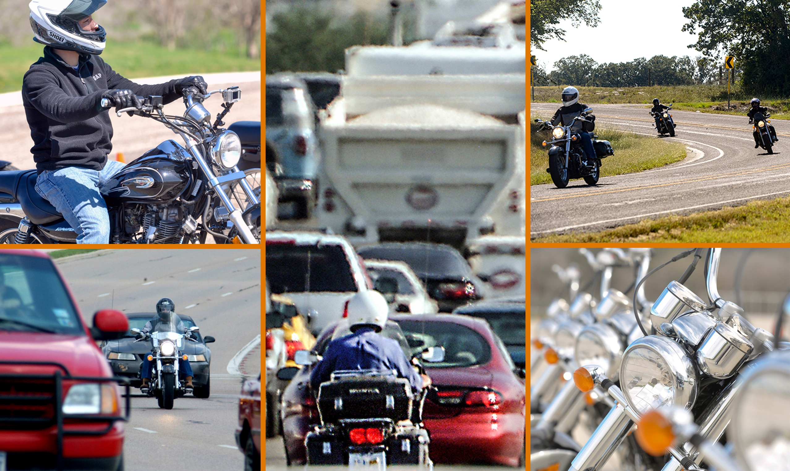
Identifying Factors and Trends to Improve Motorcycle Safety in Texas
CRASH ANALYSIS
Notes:
The title of this presentation is “Identifying factors and trends to improve motorcycle safety in Texas.” This presentation is accompanied by a series of three fact sheets and one in-depth report. These products were developed by The Center for Transportation Safety at the Texas A&M Transportation Institute. They can be downloaded from the Look, Learn, Live website.

Slide 2



Motorcycle Crashes (MC) versus Passenger Car (PC) Crashes
Objectives
Source | TxDOT Crash Records Information System (CRIS), 2015–2020 | Fatality Analysis Reporting System (FARS), 2015–2019
Notes:
This presentation has two objectives:
First, this presentation provides data comparing motorcycle crashes of ALL SEVERITIES versus passenger car crashes in Texas. These data were downloaded from TxDOT’s Crash Records Information System, commonly referred to as CRIS. The years for this analysis covered 2015 to 2020, the most recent year available. By comparing motorcycle crashes to passenger vehicle crashes, it helps to identify countermeasure that will help both types of crashes while at the same time, identifying countermeasures that may be needed to address motorcycle crashes specifically.
Second, this presentation provides data comparing FATAL motorcycle crashes in Texas versus the United States. The years for this analysis covered 2015 to 2019, the most recent year available for the Fatality Analysis Reporting System commonly referred to as FARS. These data are available from the National Highway Traffic Safety Administration(NHTSA) website. FARS data only capture fatal crashes, but since it covers the entire United States, we can make comparisons between Texas versus other states to get an idea of whether countermeasures that address motorcycle crashes need to be tailored to Texas, specifically.
Data from both sources are presented together throughout the presentation. Unless otherwise specified, a statistic referring only to fatalities is based on FARS data.

Slide 3
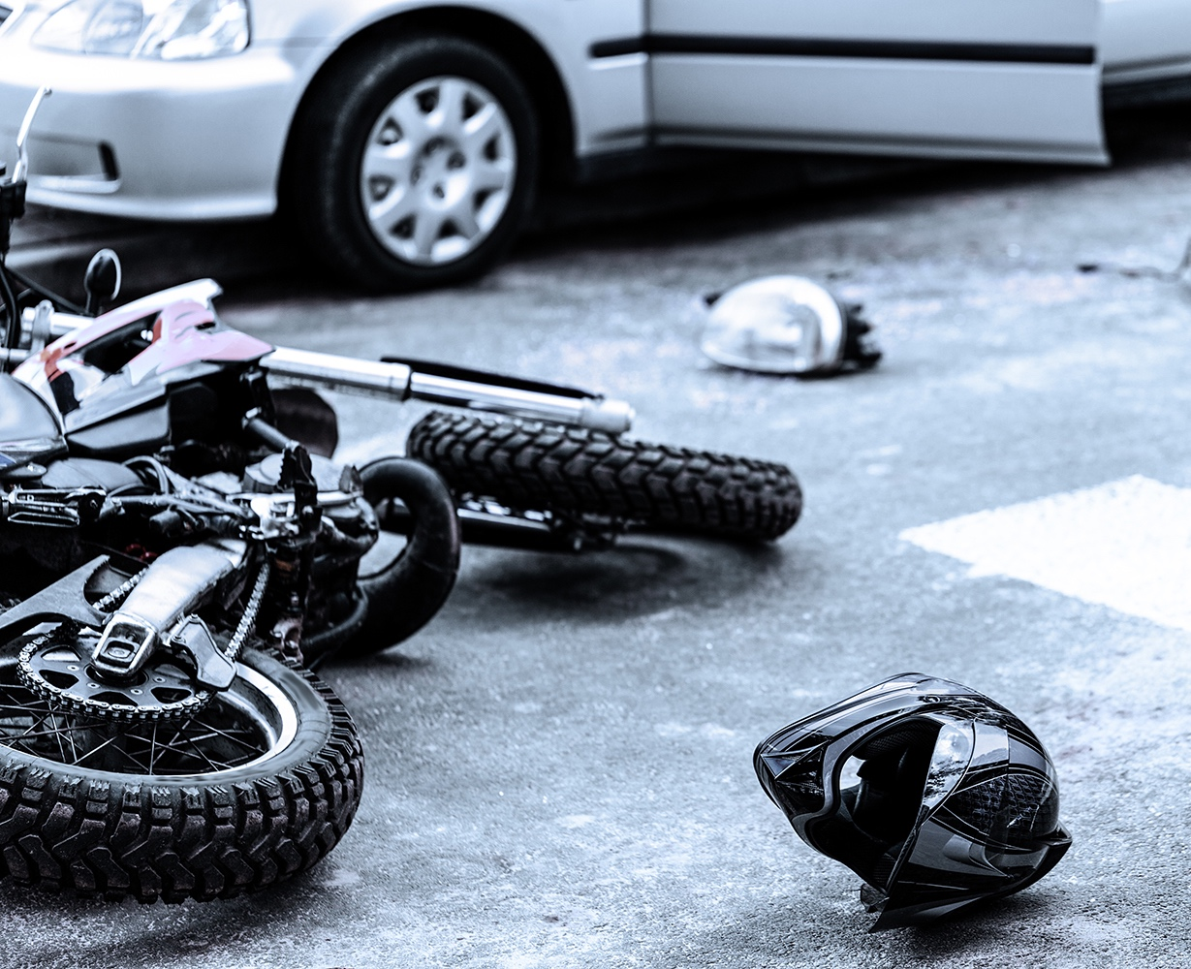
Sections
Crash Frequency
Demographics and Operator Characteristics
Crash Factors
Rear-end crashes
Notes:
This presentation is divided into fours main sections: Crash frequency, demographics & operator characteristics, crash factors, and a focused analysis of rear-end crashes.

Slide 4
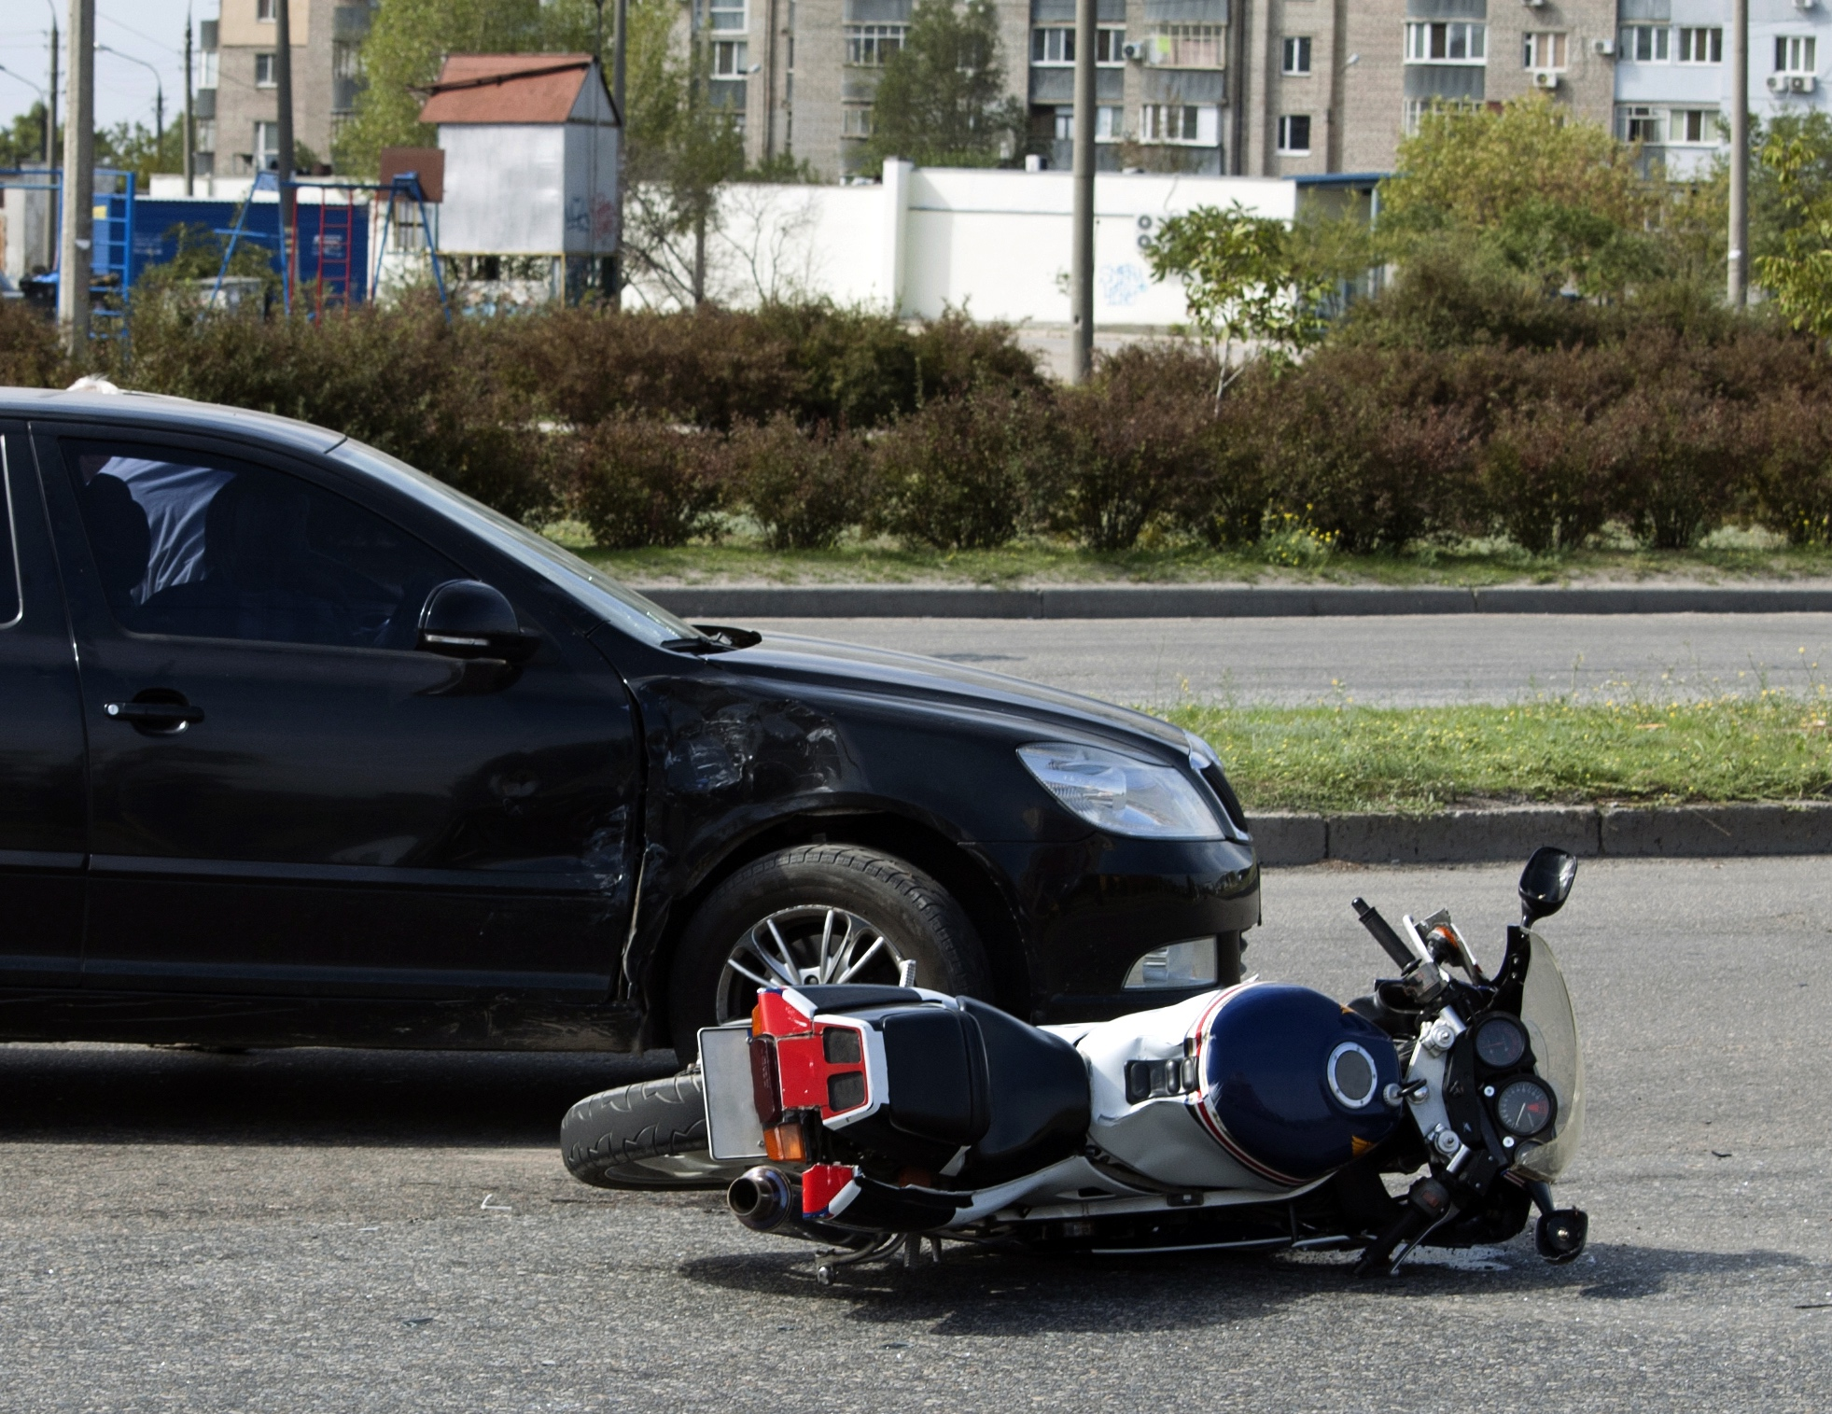
Crash Frequency
Notes:
This first section of the presentation presents the overall frequency of crashes in Texas.

Slide 5
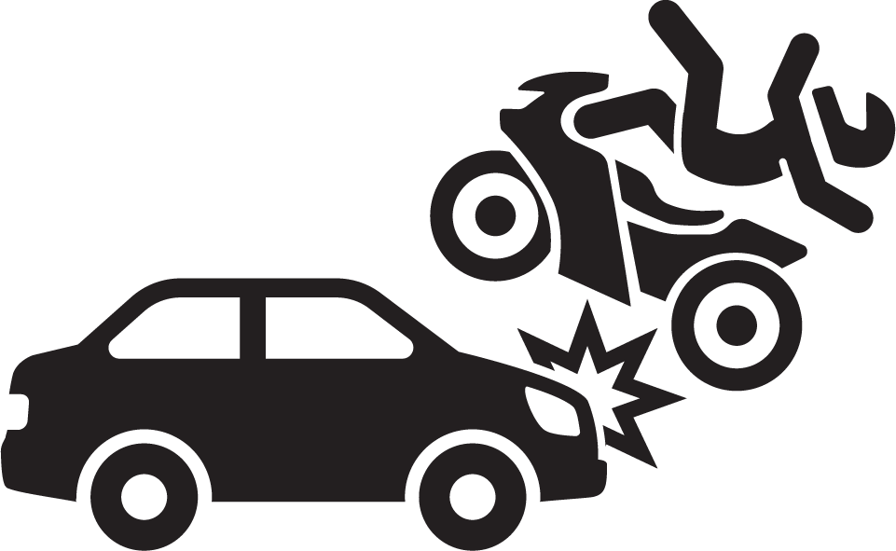

Motorcycle Crashes in Texas (2015-2020)
≈ 8,055 motorcycle-involved crashes/year
≈ 453
fatal crashes/year
≈2,131
injury crashes/year
Notes:
Overall, each year, Texas experiences approximately 8,055 crashes involving motorcycles. This equates to approximately 452 fatal motorcycle crashes each year. Each of these 452 motorcycle crashes could have involved more than one motorcycle and a motorcycle operator as well as passenger. Each year, there are approximately 2,131 motorcycle crashes each year that result in at least one injury.
TxDOT Crash Records Information System (CRIS), 2015–2020
Final Report Page 11, Figure 5.

Slide 6
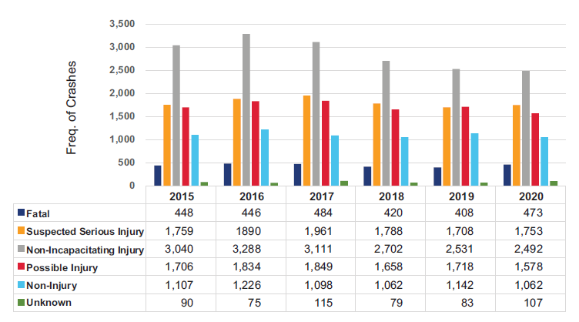
Notes:
This graph displays the frequency of motorcycle crashes by year and their severity. Overall, the greatest proportion of motorcycle crashes are non-incapacitating followed by suspected serious injury, possible injury, non-injury and fatality. Please note that crash severity is assigned as the injury of greatest severity sustained by anyone involved in the crash. Most often, this is the motorcycle operator. Of concern, from 2019 to 2020, the number of fatal crashes increased from 408 to 473 and the number of suspected serious injury crashes increased by 1,708 to 1,753. Therefore, the decreasing trend observed from at least 2017 to 2019 is starting to reverse course.
“Crashes” Fact Sheet - TxDOT Crash Records Information System (CRIS), 2015–2020

Slide 7
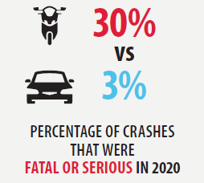
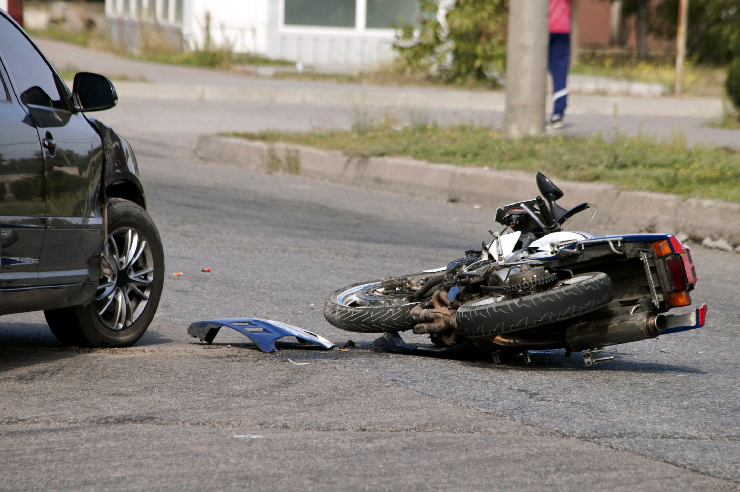
Severity Comparison
Notes:
To put severity into perspective, 30% of motorcycle crashes are fatal or suspected serious injury versus only 3% of passenger v
vehicles.
“Crashes” Fact Sheet - TxDOT Crash Records Information System (CRIS), 2020

Slide 8
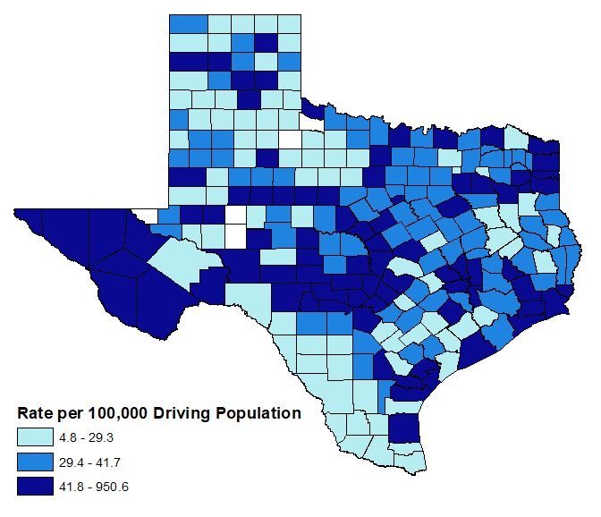
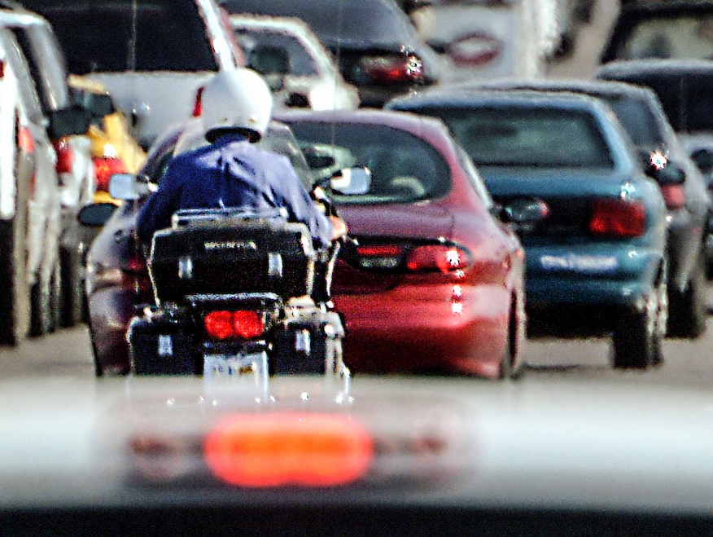
Annual Motorcycle Crash Rate Per 100,000 Driving Population (2015-2020)
Notes:
There are different ways of computer crash rates for motorcycles. We can examine raw counts and percentages by crash severity and year as we just did on the prior slide. Examining raw counts, however, doesn’t account for whether or not more people are riding motorcycles or whether people are riding motorcycle more often. To be able to make better comparisons over time or places, we can compute rates or the number of motorcycle crashes divided by the size of the driving population, the number of registered motorcycles, or an estimate of the amount of miles motorcycles travel on Texas roadways each year.
The next three slides illustrate three different ways of computing crash rates.
First, shown here, we see the rate of motorcycle crashes per 100,000 driving population by each of the 254 counties in Texas. Using this metric, the highest rate of motorcycle crashes are in the counties in dark blue, concentrated in far West Texas and central Texas as well as other counties.
TxDOT Crash Records Information System (CRIS), 2015–2020
Final Report Page 13, Figure 7.

Slide 9
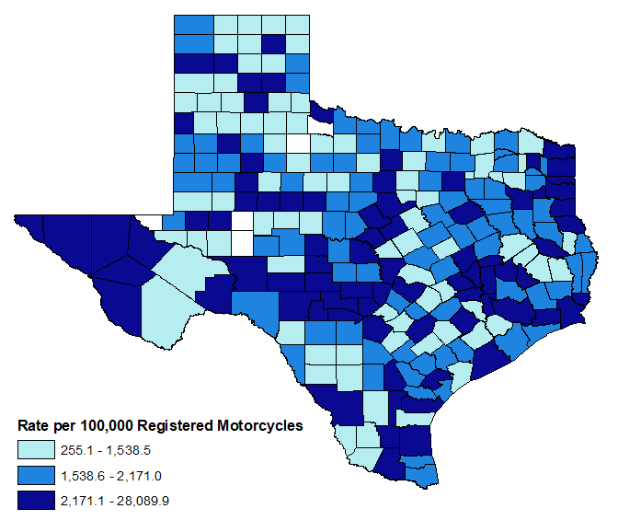
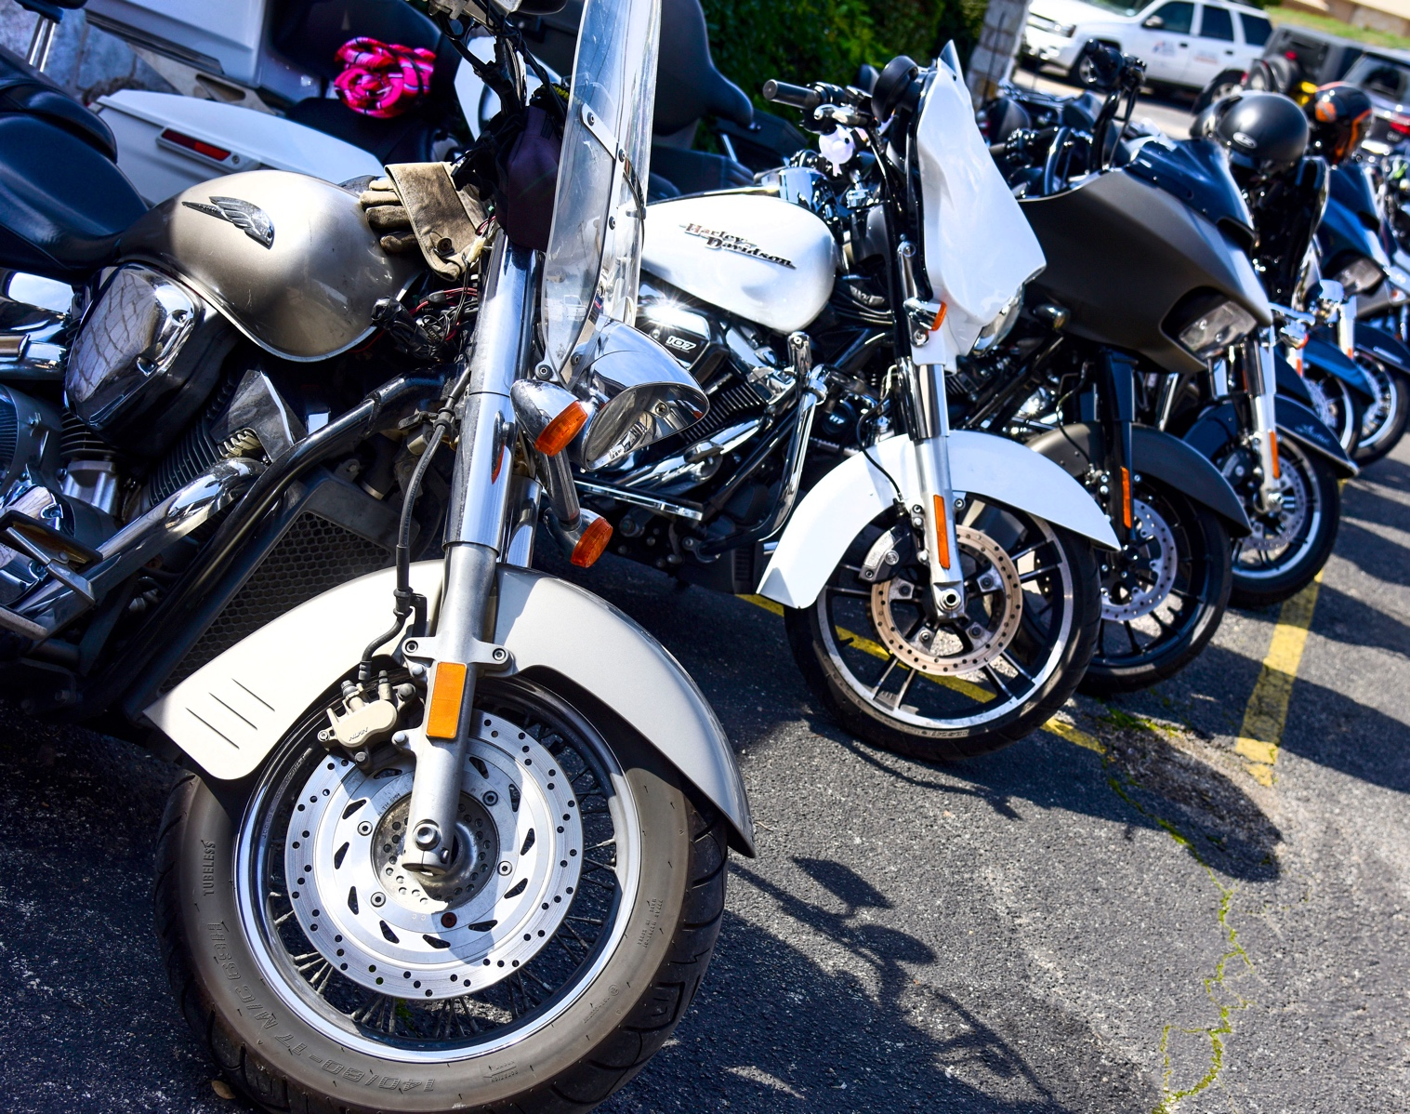
Motorcycle Crash Rate Per 100,000 Registered Motorcycles (2015-2020)
Notes:
This figure displays a second type of rate, this is motorcycle crashes per 100,000 registered motorcycles displayed by county. Compared to prior figure, many of the same counties are colored dark blue or having a high crash rate per number of re
registered motorcycles.
“Crashes” Fact Sheet - TxDOT Crash Records Information System (CRIS), 2015–2020

Slide 10

Crash Rate Per 100 Million VMT in Texas (2019)
 | Fatal Crash Rate | Suspected Serious Injury Crash Rate | Fatal and Suspected Serious Injury Crash Rate | Total Crash Rate
Motorcycles | 32.9 | 138.4 | 171.3 | 608.6
All Vehicles | 1.1 | 4.5 | 5.6 | 195.1
30x
higher
31x
higher
31x
higher
3x
higher
Notes:
This slide illustrates motorcycle crash rate per vehicle miles traveled or VMT. Using VMT often in a preferred way of computing rates since it takes into consideration an estimate of the number of miles actually spent on the roadway, or the amount of exposure time at risk of getting into a crash.
TTI developed a method for estimating motorcycle VMT in Texas on an annual basis using a variety of data sources including population size, registration data, and household travel survey data.
This table shows the rate of fatal crashes, suspected serious injury crashes, fatal and suspected serious injury crashes combined, and total crashes per VMT for motorcycles compared to the same rates per VMT for all vehicles.
If we just look at the raw number of crashes, we find there are many more crashes involving vehicles that are not motorcycles than motorcycles each year in Texas. But if we examine the crash rates, we see that the rates of fatal and suspected serious injury crashes involving motorcycles is about 30 times that of the crash rate per VMT overall. It is about three times as high if we compute the rate for across all crash severities.
(1,234,042,832 motorcycle; 288,226,726,953 all)
Texas, 2019 CRIS data

Slide 11
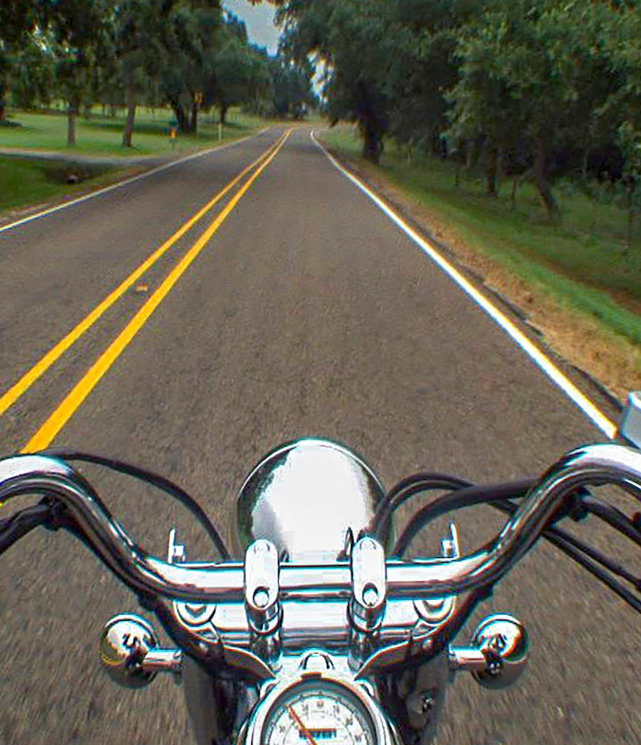
Demographics and Operator Characteristics
Notes:
The next section examines demographic and operator characteristics and how they are distributed across motorcycle versus passenger vehicle crashes.

Slide 12


Who is involved in crashes in Texas?
(2015-2020)
Motorcycle Operator
Passenger Car Driver
Notes:
Age is one of the strongest factors associated with high risk driving behaviors. Across crashes of all severities, the largest proportion of motorcycle operators were ages 25 to 44 years old (44%). The second largest age group was 45 to 59 years old (25%). The third largest group was 16 to 24 years old (18%).
The age distribution for passenger vehicle drivers involved in crashes was a little bit different. The largest proportion also was the 25 to 44 years old group (39%). But the second largest group was the 16 to 24 years old group (24%) and the third was the 45 to 59 years old group (1%) .
"Rider Factors” Fact Sheet – TxDOT Crash Records Information System (CRIS), 2015–2020

Slide 13

Who is involved in crashes in Texas?
(2015-2020)
Motorcycle Operator
95% male
Passenger Car Driver
52% male
This Photo by Unknown Author is licensed under CC BY-SA
Notes:
By far, the majority of motorcycle operators involved in crashes are male at 95%. This is far higher than the proportion of male drivers of passenger vehicles, which account for 52%, much more similar to the proportion of males in the general population.
"Rider Factors” Fact Sheet – TxDOT Crash Records Information System (CRIS), 2015–2020

Slide 14


License Status in Texas (2015-2020)
Motorcycle Operator
Passenger Car Driver
41% did not possess the valid license/endorsement for a motorcycle
11% did not possess a valid license for vehicle class
Notes:
With respect to licensing, 41% of motorcycle operators did not have a valid motorcycle license or endorsement. Only, 11% of drivers of passenger vehicles did not have a valid license for the class of their vehicle.
"Rider Factors” Fact Sheet – TxDOT Crash Records Information System (CRIS), 2015–2020

Slide 15
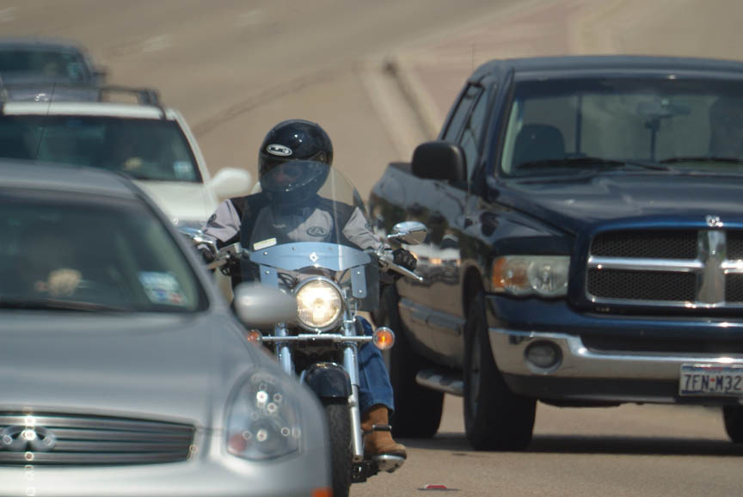
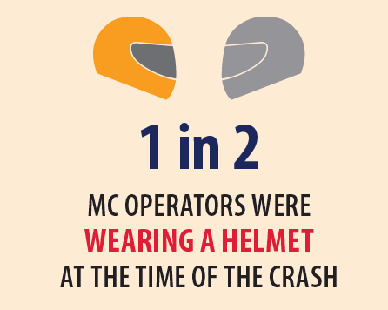
Helmet Status in Texas (2015-2020)
Motorcycle Operator
Notes:
Helmet use is not mandatory in Texas. About half of motorcycle operators in crashes were wearing a helmet. Among fatalities the percentage dropped to about 39% which is lower than the US overall. For the nation, the percentage is about 49%.
"Rider Factors” Fact Sheet – TxDOT Crash Records Information System (CRIS), 2015–2020

Slide 16
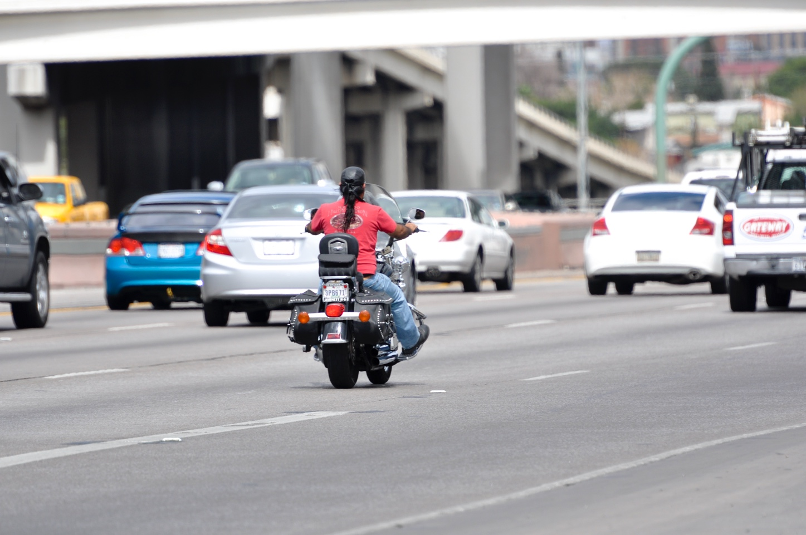
Helmet Status (2015-2019)
Motorcycle Operator Fatalities
39% of operator fatalities were wearing a helmet in TX vs
49% in the U.S.
Notes:
Helmet use is not mandatory in Texas. About half of motorcycle operators in crashes were wearing a helmet. Among fatalities the percentage dropped to about 39% which is lower than the US overall. For the nation, the percentage is about 49%.
"Rider Factors” Fact Sheet – Fatality Analysis Reporting System (FARS), 2015–2019

Slide 17
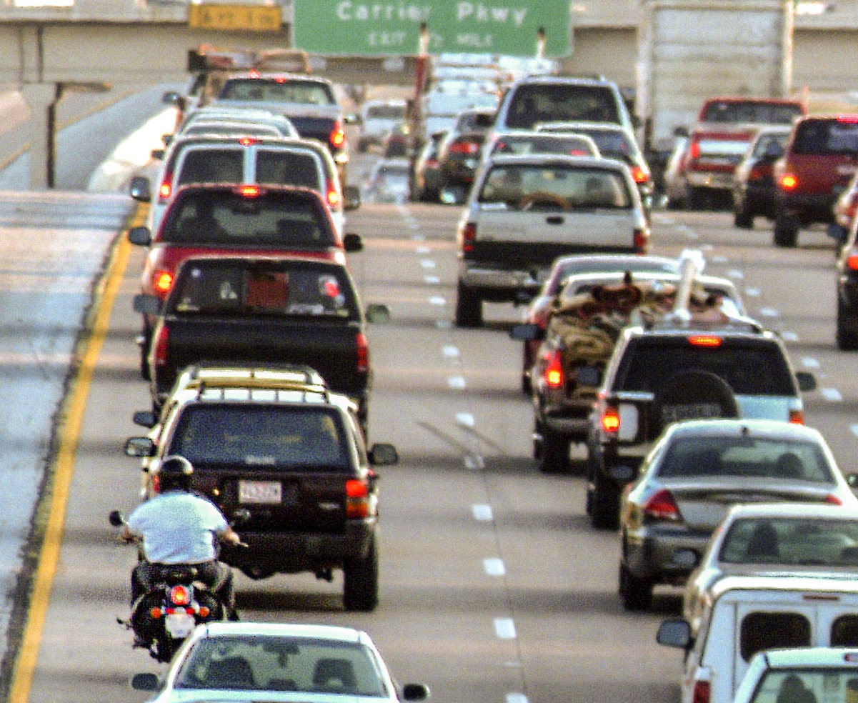
Crash Factors
Notes:
The next section examine factors that may be associated with motorcycle crashes or that increase their severity.

Slide 18
Comparing Environmental Factors in Texas (2015-2020)
Motorcycle Crashes
Passenger Car Crashes
79% clear weather
94% dry surface condition
12% dark-not lighted condition
69% clear weather
86% dry surface condition
8% dark-not lighted condition
Notes:
This slide examines environmental conditions.
Overall, motorcycle crashes occur under clear weather conditions, nearly 80%, dry surface conditions, 94%, with a low proportion occurring under dark not lighted conditions, about 12%.
For passenger car crashes, the proportions occurring under clear weather conditions is lower at nearly 70% and 86% occurred on dry surface conditions.
Higher percentages under favorable driving conditions may be a function of motorcycle operators avoiding poor driving conditions.
About 8 percent of passenger car crashes occurred under dark not lighted conditions, somewhat lower than motorcycle crashes.
”Crashes” Fact Sheet – TxDOT Crash Records Information System (CRIS), 2015–2020

Slide 19
Motorcycles and Passenger Car Crashes by Number of Vehicles in Texas (2015-2020)
37%
of motorcycle crashes
10%
of passenger car crashes
were single vehicle crashes
Notes:
A large proportion of motorcycle crashes are single vehicle crashes, 37%. This is much higher than passenger car crashes, of w
which only 10% are single vehicle crashes.
“Crashes” Fact Sheet – TxDOT Crash Records Information System (CRIS), 2015–2020

Slide 20
Comparing Crash Factors in Texas
(2015-2020)
Motorcycle Crashes
Passenger Car Crashes
17% of fatal or serious (KA) crashes were speed related
10% of all crashes were speed related
7% of fatal or serious (KA) crashes were speed related
3% of all crashes were speed related
Notes:
Speed is one of the biggest predictors of crash severity. This pattern is exhibited in the data shown on this slide. 10% of all motorcycle crashes are speed related, but the percentage increased to 17% for fatal and serious motorcycle crashes.
Speed played less of a role in passenger car crashes as listed in only 3% of all passenger car crashes. But this percentages more than doubled to 7% for fatal and serious passenger car crashes, indicating the speed also increases crash severity in passenger car crashes.
"Rider Factors” Fact Sheet – TxDOT Crash Records Information System (CRIS), 2015–2020
Final Report Page 27, Figure 24

Slide 21
Comparing Crash Factors in Texas
(2015-2020)
6%
of motorcycle crashes
10%
of passenger car crashes
involved distraction
Notes:
Distraction is much lower in motorcycle crashes compared to passenger car crashes, 6% versus 10%. This may be a function of the fact that it is a lot harder to use a mobile device while riding compared to driving a car.
"Rider Factors” Fact Sheet – TxDOT Crash Records Information System (CRIS), 2015–2020
Final Report Page 28, Figure 25

Slide 22
Comparing Crash Factors in Texas
Motorcycle Crashes
Passenger Car Crashes
All Crashes (2015-2020)
  1% involved drug impairment
  3% involved a positive blood alcohol concentration (BAC)(alcohol impairment)
Fatal Crashes (2015-2019)
  12% involved drug impairment
  24% involved a blood alcohol concentration (BAC)(alcohol impairment)
All Crashes (2015-2020)
  0.1% involved drug impairment
  1% involved a blood alcohol concentration (BAC)(alcohol impairment)
Fatal Crashes (2015-2019)
  10% involved drug impairment
  17% involved a blood alcohol concentration (BAC)(alcohol impairment))
Notes:
Overall, a small percentage of overall crashes were coded as involving drug impairment of alcohol impairment as measured with a blood alcohol concentration test or BAC. However, the percentages increase greatly for fatal crashes with the percentages higher for motorcycle crashes compared to passenger car crashes.
For example, 12% and 24% of fatal motorcycle crashes involved drug or alcohol impairment. For comparison, 10% and 17% of passenger car crashes involve drug or alcohol impairment, respectively.
For the US except Texas, 8% of fatal motorcycle and passenger car crashes involved drug impairment. The percentages of positive BAC was comparable for Texas versus other states.
"Rider Factors” Fact Sheet – TxDOT Crash Records Information System (CRIS), 2015–2020 and
Fatality Analysis Reporting System (FARS), 2015–2019

Slide 23


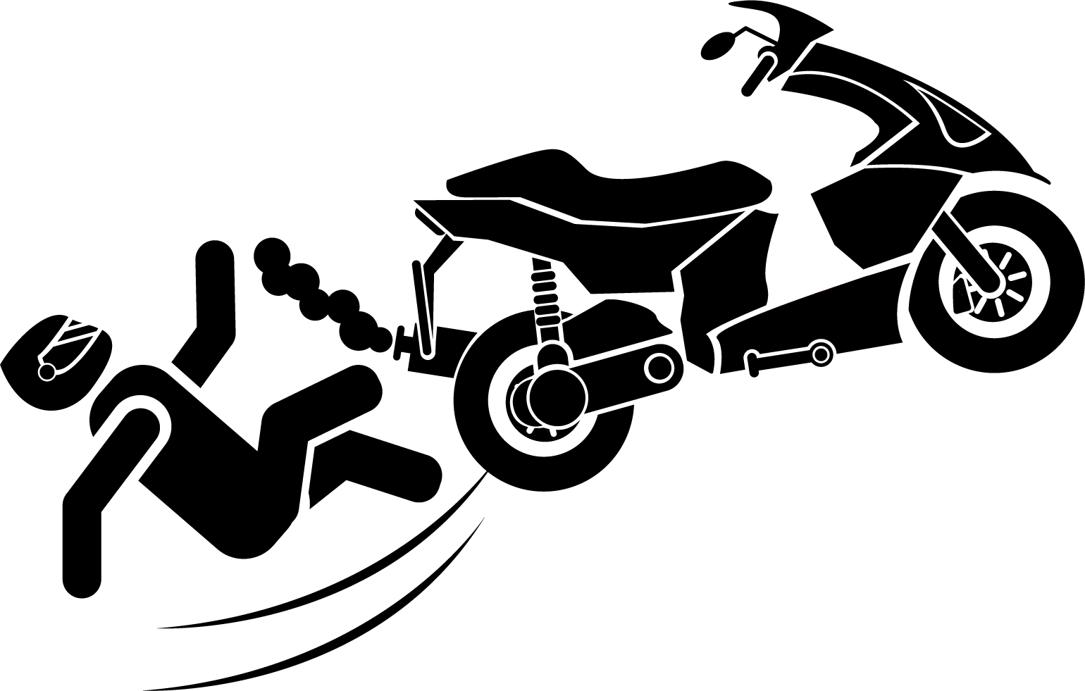
Motorcycle Driver-Related Factors in Texas
(2015-2020)
16.5%
Failed to Control Speed
9.0%
Unsafe Speed
6.9%
Animal on Road-Wild
5.2%
Changed Lane When Unsafe
6.3%
Driver Inattention
Notes:
For motorcycle crashes, in addition to speed and distraction, two other issues made the top 5 - animals in the roadway contributed to 7% of crashes while changed lane when unsafe was also an issue for 5% of crashes.
Failure to control speed was also top issue for passenger car crashes. Driver inattention was a greater concern than motorcycle crashes-taking second place. Change lane when unsafe was also a concern in 5% of passenger crashes, the same a motorcycle crashes. Two other concerns for passenger cars were failed to drive in a single lane and failed to yield the row of way while turning left.
"Rider Factors” Fact Sheet – TxDOT Crash Records Information System (CRIS), 2015–2020

Slide 24


Passenger Driver-Related Factors in Texas
(2015-2020)
5.4%
Changed Lane When Unsafe
11.9%
Driver Inattention
18.5%
Failed to Control Speed
4.7%
Failed to Drive in
Single Lane
4.6%
Failed to Yield ROW - Turning Left
Notes:
For motorcycle crashes, in addition to speed and distraction, two other issues made the top 5 - animals in the roadway contributed to 7% of crashes while changed lane when unsafe was also an issue for 5% of crashes.
Failure to control speed was also top issue for passenger car crashes. Driver inattention was a greater concern than motorcycle crashes-taking second place. Change lane when unsafe was also a concern in 5% of passenger crashes, the same a motorcycle crashes. Two other concerns for passenger cars were failed to drive in a single lane and failed to yield the row of way while turning left.
"Rider Factors” Fact Sheet – TxDOT Crash Records Information System (CRIS), 2015–2020

Slide 25

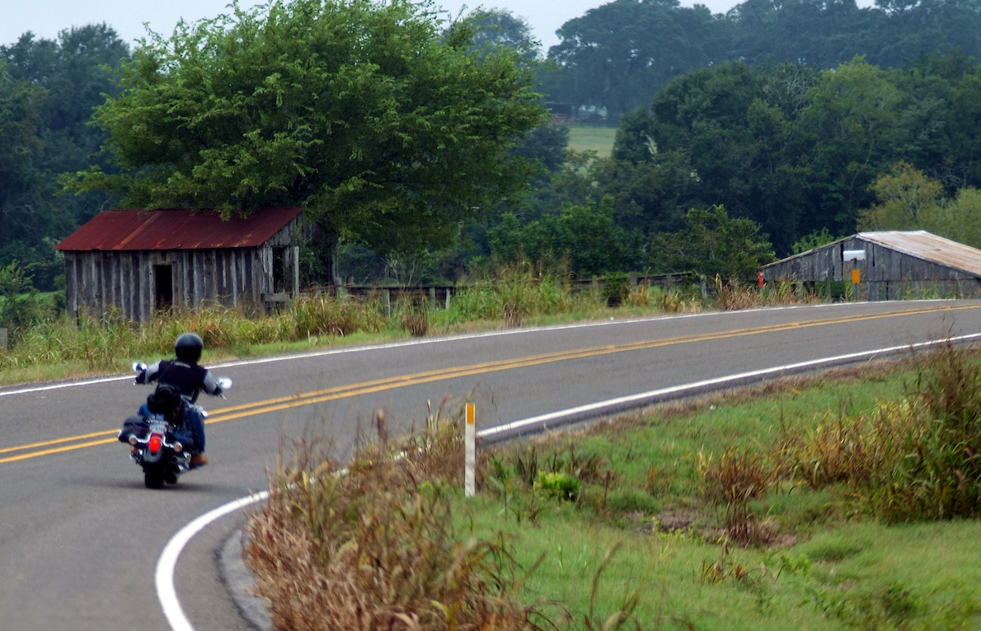
Roadway Factors in Texas (2015-2020)
18% of MC crashes
vs
7% of PC Crashes Curve-related
Notes:
Curves are a much larger concern for motorcycle crashes, with it being a factor in 18% of motorcycle crashes, but only 7% of passenger car crashes.
“Crashes” Fact Sheet – TxDOT Crash Records Information System (CRIS), 2015–2020

Slide 26

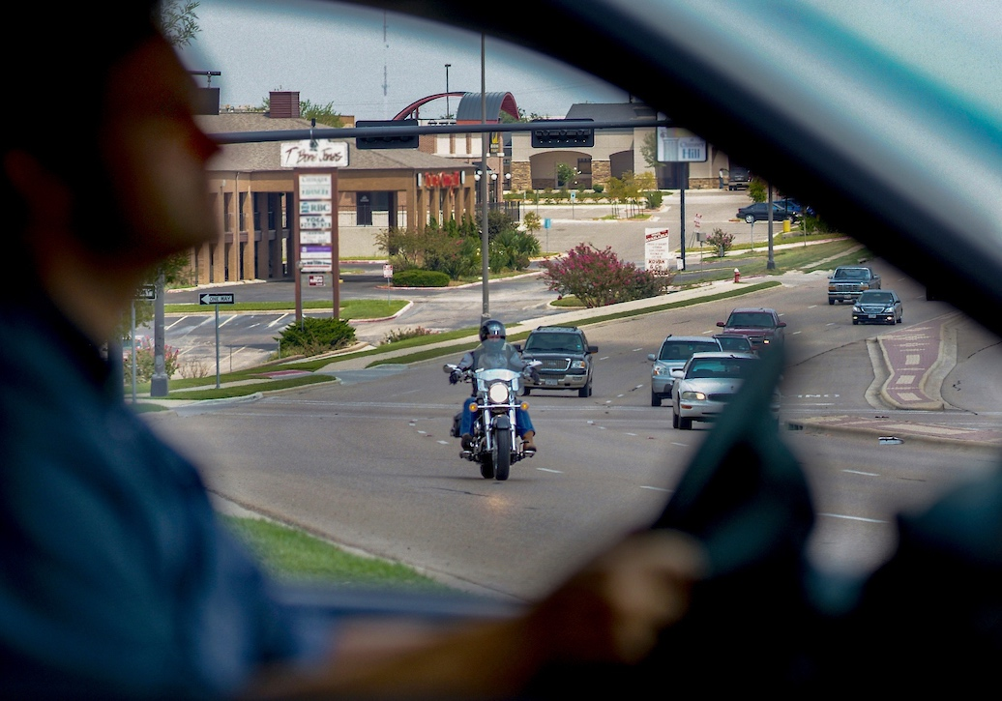
Roadway Factors in Texas (2015-2020)
34% of MC
vs
43% of PC Crashes Intersection-related
Notes:
Intersections are a concern for crashes because they are a part of the roadway where vehicles are more likely to have to negotiate around each other. Over one-third of motorcycle crashes occurred at an intersection or were intersection-related. This proportion is even higher among passenger car crashes at 43%.
“Roadway Factors” Fact Sheet – TxDOT Crash Records Information System (CRIS), 2015–2020

Slide 27

Roadway Factors: Intersections in Texas (2015-2020)
40%
44%
percentages of crashes at intersections
occurring in dark conditions
Notes:
Similar proportions of motorcycle crashes and passenger car crashes at intersections occur in dark conditions with 40%of motorcycle and 44% of passenger car crashes. Both proportions are high potentially due to decreased visibility under dark conditions that may be heightened for motorcycle especially if the rider is not wearing high visibility gear.
“Roadway Factors” Fact Sheet – TxDOT Crash Records Information System (CRIS), 2015–2020
Final Report Page 72, Table 37 shows 40% and 44% - Slide & text revised

Slide 28
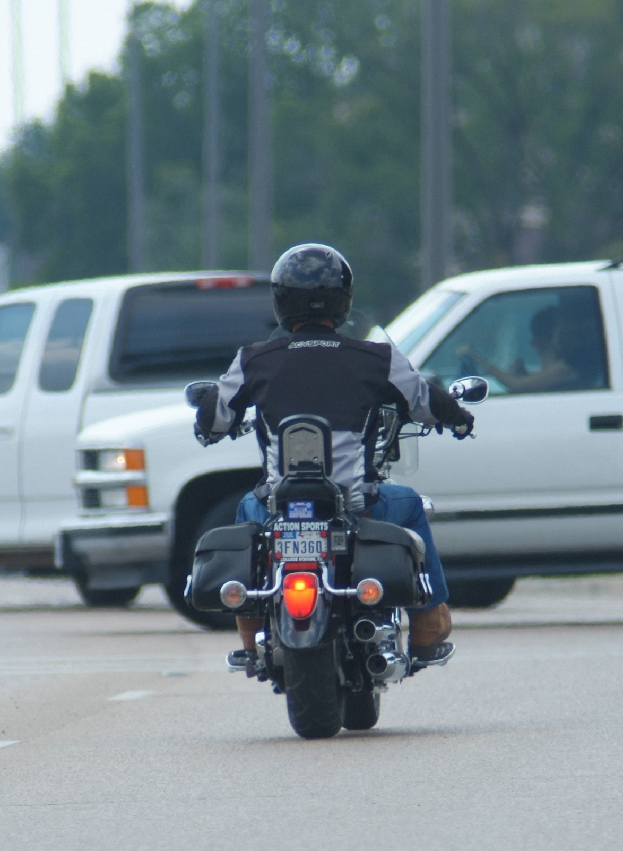
Rear-End Crashes
Notes:
A more intensive analysis was conducted of rear-end motorcycle crashes that happened in 2019. Only one year of data were used because we had to analyze the crash narratives and other fields to determine whether or not the motorcycle rear-ended the other vehicle or the other vehicle rear-ended the motorcycle.
“Roadway Factors” Fact Sheet – TxDOT Crash Records Information System (CRIS), 2019

Slide 29
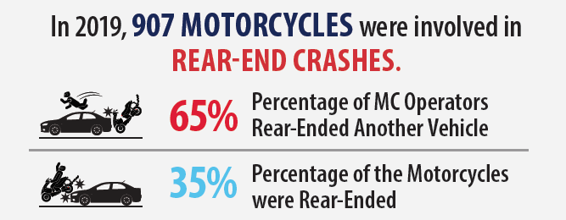
Rear-End Crashes in Texas
Notes:
In 2019, there were 907 motorcycles involved in rear-end crashes. In the majority of these crashes (65%), the motorcycle rear-ended the other vehicle.

Slide 30
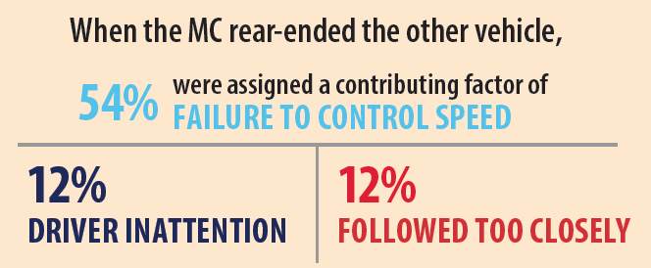

Rear-End Crashes in Texas (2019)
Notes:
When the MC rear-ended the other vehicle, the operator was often assigned a contributing factor of failure to control speed (54%). There were 12% that were assigned driver inattention and 12% assigned following too closely.
“Roadway Factors” Fact Sheet – TxDOT Crash Records Information System (CRIS), 2019

Slide 31
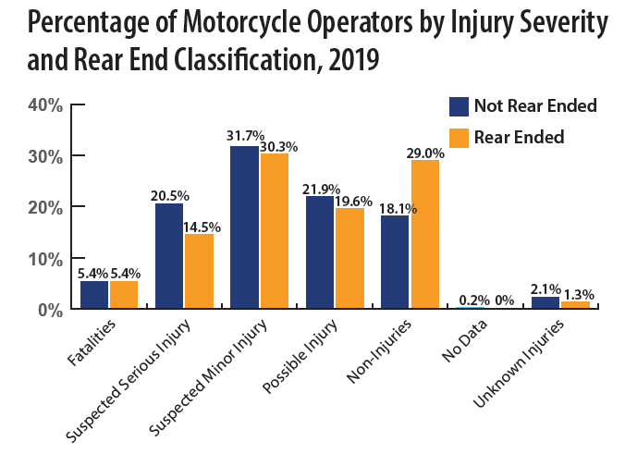
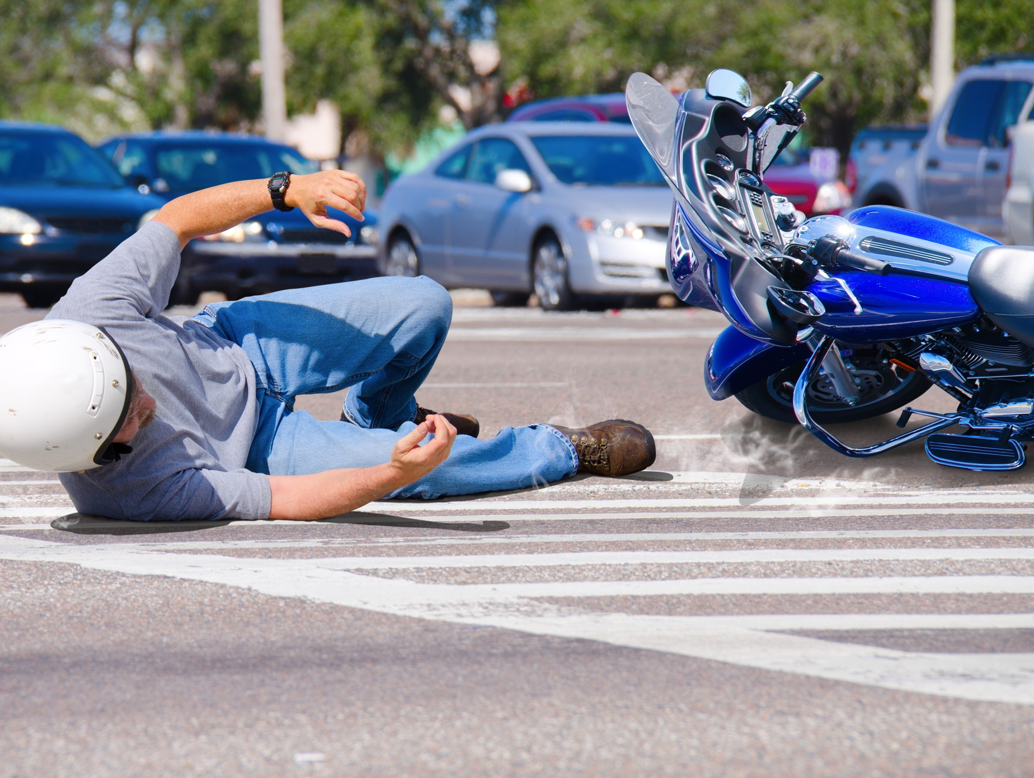
Rear-End Crashes in Texas
Notes:
Injury severity varied somewhat when by rear-end status. When the motorcycle rear-ended, the percent that sustained a suspected serious injury was 21% versus 15% when the motorcycle was rear-ended by the other vehicle. Conversely, 18% of motorcycle operators sustained no injury when they rear-ended the other vehicle by this increased to 29% when the motorcycle operator was rear-ended by the other vehicle. Therefore, being rear-ended by another vehicle increased injury severity but not fatality.
“Roadway Factors” Fact Sheet – TxDOT Crash Records Information System (CRIS), 2019

Slide 32
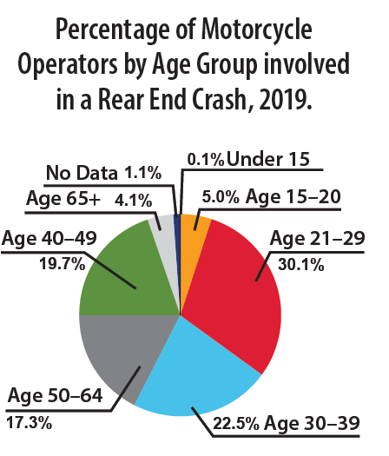
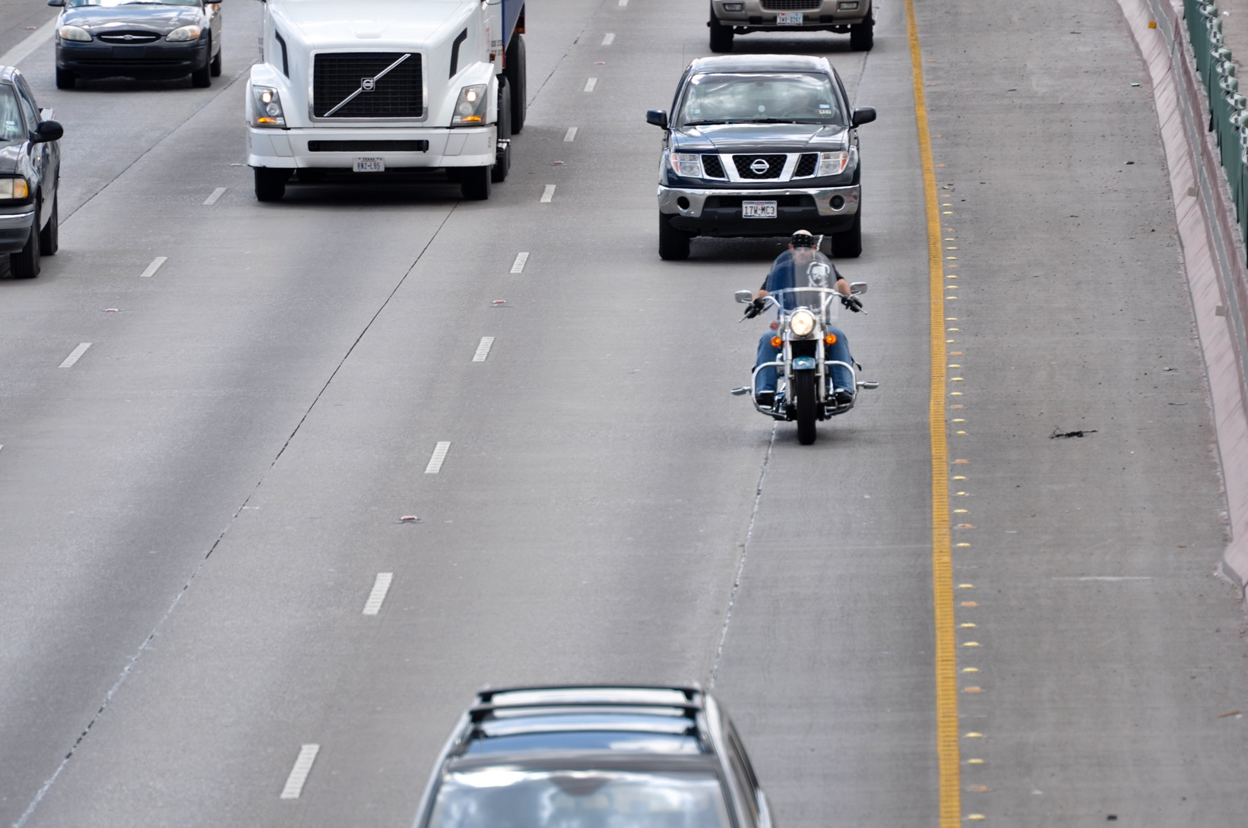
Rear-End Crashes in Texas
Notes:
With respect to age, the largest age group involved in rear end crashes were in the 21 to 29 year-old group at 30% followed by those ages 30 to 39 year-old group at 23%. This is larger than the distribution of these ages in crashes overall, indicating an overrepresentation for these age groups.
“Roadway Factors” Fact Sheet – TxDOT Crash Records Information System (CRIS), 2019

Slide 33
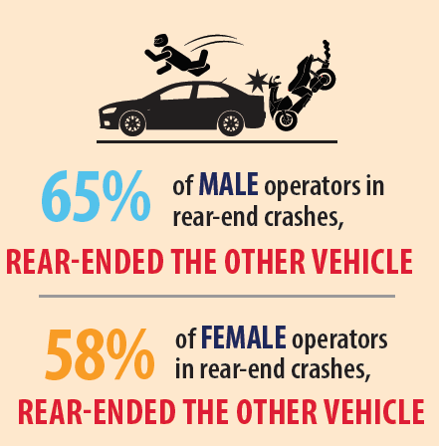
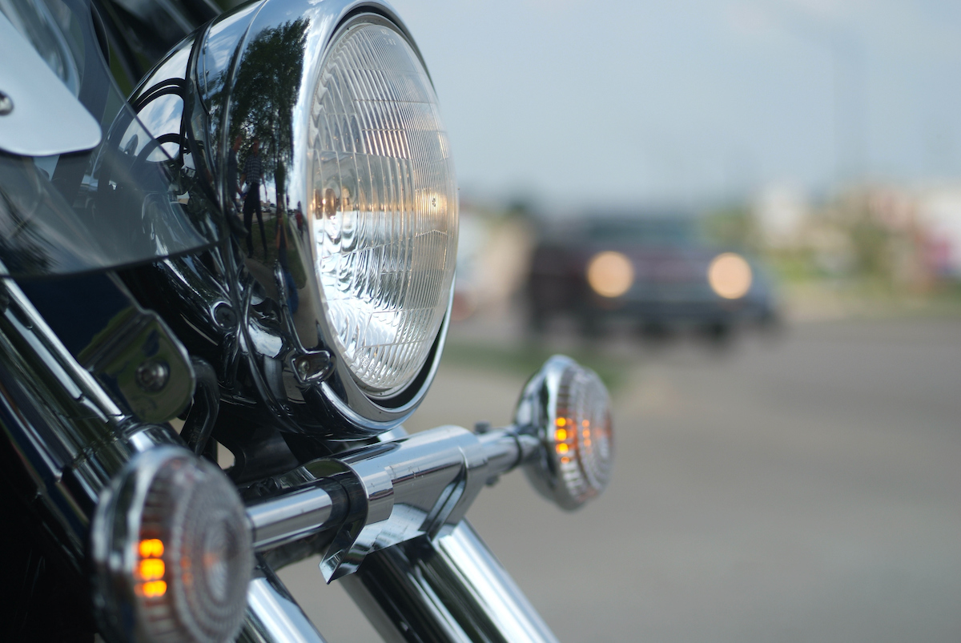
Rear-End Crashes in Texas (2019)
Notes:
With respect to gender, 65% of male operators involved in rear-end crashes rear-ended the other vehicle compared to 58% of female operators.
“Roadway Factors” Fact Sheet – TxDOT Crash Records Information System (CRIS), 2019

Slide 34
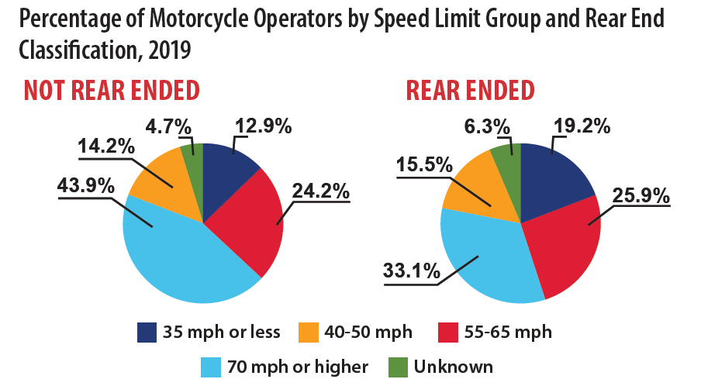
Rear-End Crashes in Texas
Notes:
These two pie charts display the distribution of posted speed limit by whether the motorcycle rear-ended the other vehicle or was rear-ended by the other vehicle. Rear-ending the other vehicle was associated with a higher proportion of posted speed limits of 70 mph or higher.
“Roadway Factors” Fact Sheet – TxDOT Crash Records Information System (CRIS), 2019

Slide 35
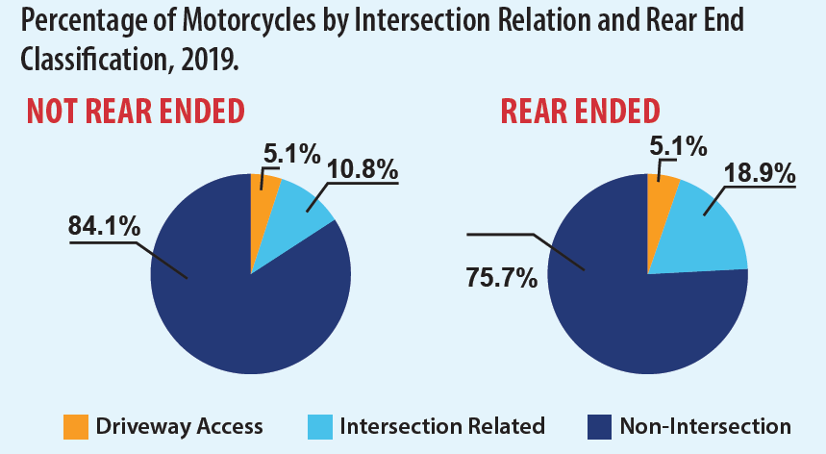
Rear-End Crashes in Texas
Notes:
Finally, these two pie charts display intersection relationship by whether the motorcycle rear-ended the other vehicle or was rear-ended by the other vehicle.
Rear-ending the other vehicle was associated with a lower proportion of being intersection related at 11% versus 19% if the motorcycle was rear-ended by the other vehicle.
Overall, of interest, the vast majority of rear-end crashes were not at intersections or intersection related.
“Roadway Factors” Fact Sheet – TxDOT Crash Records Information System (CRIS), 2019

Slide 36

Questions?
Eva Shipp, PhD
Senior Research Scientist, Manager
TTI Center for Transportation Safety
e-shipp@tti.tamu.edu
This Photo by Unknown Author is licensed under CC BY
Notes:
Overall, the data paint a picture of motorcycle crashes having sharing some characteristics with passenger cars but differ in the distribution of other factors.
Motorcycles riders are vulnerable given that their bodies are exposed to the elements and roadway. In addition, they may not be visible to the drivers of larger vehicles.
This is why it is important to Look Twice for Motorcycles while we Share the Road.
If you have any questions about this presentation or our other products, please feel free to contact me at e-shipp@tti.tamu.edu.
Thanks and stay safe!

