Slide 1
Texas Motorcycle Safety Coalition Quarterly Meeting
September 2, 2021
10:00 am – 11:30 am

Slide 2
Agenda
10:00 – 10:05 AM Opening Remarks & Introductions (Chris B.)
10:05 – 10:10 AM Refresher on how to use Webex (Mike)
10:10 – 10:15 AM 2021 In Review (Mike)
10:15 – 10:20 AM 2022 Preview Impairment Project (Laura)
Motorcycle Safety Strategic Plan (Mike)
Training and Licensing Project (Cody)
10:20 – 10:25 AM Task Force Activity Update (Cathy)
10:25 – 10:45 AM Training and Licensing Project,
Guests Cody Stewart & Marcie Perez
10:45 – 11:15 AM Barriers vs. Motorcycle,
Guest Speaker Chiara Silvestri Dobrovolny
11:15 – 11:25 AM Updates, Open Forum(open)
11:30 AM Adjourn

Slide 3
WebEx Refresher
Please stay muted (Jack will help with this)
This limits distracting sounds and noises that detract from the meeting. TTI will also be muting people.
Don’t put us on “hold”.
Participate in the meeting.
Use WebEx chat.
Or after the meeting, send us a note using the Contact Us page on looklearnlive.org.

Slide 4
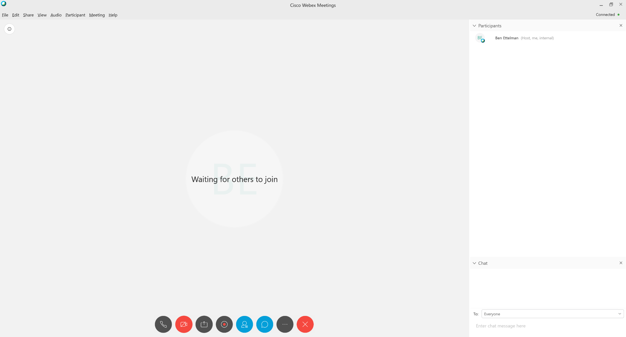
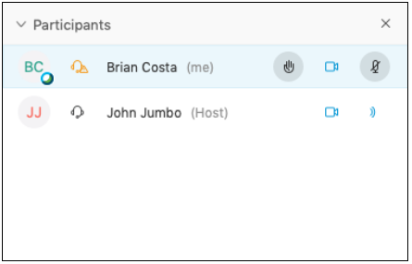
WebEx Refresher
2
Raise your hand
Chat will appear here
1
2
Click to open chat box
Enter text here then press return

Slide 5
2021 TxDOT Grant Review
Best Practices Document for Educating Motorcycle Safety Stakeholders and Riders
Coalition Growth – 28 new members
Presentations – 4 complete, 2 planned Sept. 11th
Forum – held May 1st
Social Media –
966 posts across Facebook, Twitter, and Instagram
~94,000 Impressions* through Facebook, Twitter, and Instagram
900+ YouTube views** that equal over 30 hours of viewing
*impressions = eyeballs that see our posts
**include US and international views
As of July 2021
Notes:
Coalition Growth – 28 new members
Presentations – 4 complete, 2 planned Sept. 11th
Forum – held May 1st
Social Media – 966 posts to Facebook, Twitter, & Instagram for 94,000+ impressions and 900+ You Tube views for 30+ hours.

Slide 6
Pledge
#TxIRideForTomorrow
A pledge for motorcyclist to ride responsibly, sober, smart, and safe.
#TxMotorcycleSafetyPledge (in development)
A pledge for passengers, family & friends, and other motorists to do their part to increase safety for motorcyclist.

Slide 7
2022 Preview
Motorcycle Stakeholder Toolkit to prevent impaired riding crashes
Motorcycle Safety Outreach and Education
5 Year Strategic Motorcycle Safety Plan
Motorcycle Safety Forum (Late April)
Outreach and Education to motorists and motorcyclists
TMSC (Dec. 2, Mar. 3, Jun. 9, Sept. 8)
Training and Licensing to encourage more riders to complete motorcycle safety training and continue promoting a culture of rider safety in Texas.
Notes:
Training and Licencing: Yes, this project has been funded for another year. The project’s goal is to encourage more riders to complete motorcycle safety training and continue promoting a culture of rider safety in Texas.

Slide 8
TMSC Task Force - Task One
Topic Focus: Rider Impairment
Next Steps:
Develop survey to determine target behaviors and potential countermeasures
Develop campaign strategies and materials
Implement pilot
Notes:
TF decided to focus on impaired riding as it is one of the primary factors contributing to MC fatalities and suspected serious injuries. Now there is a need to examine the topic further to create a targeted campaign.
The TF is planning on a multi-year effort because of the enormity of the problem.

Slide 9
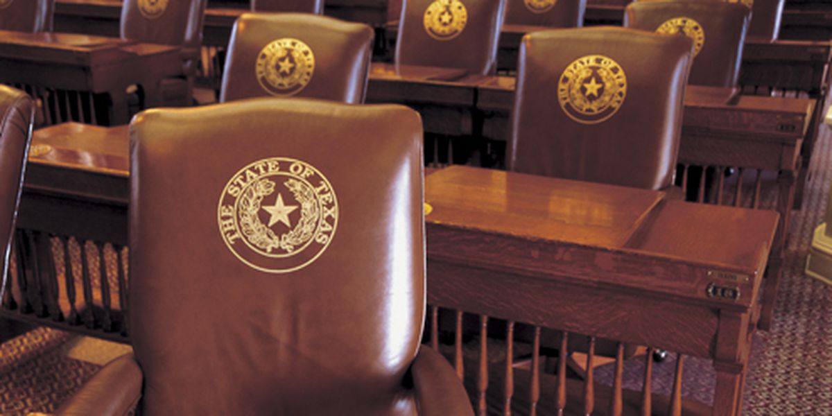
TMSC Task Force
Legislative Update

Slide 10
Training and Licensing Project
Cody Stewart
Marcie Perez

Slide 11
Thank you!
Cody Stewart
Marcie Perez

Slide 12
Barriers vs. Motorcycle
Chiara Silvestri Dobrovolny

Slide 13
Thank you!
Chiara Silvestri Dobrovolny

Slide 14
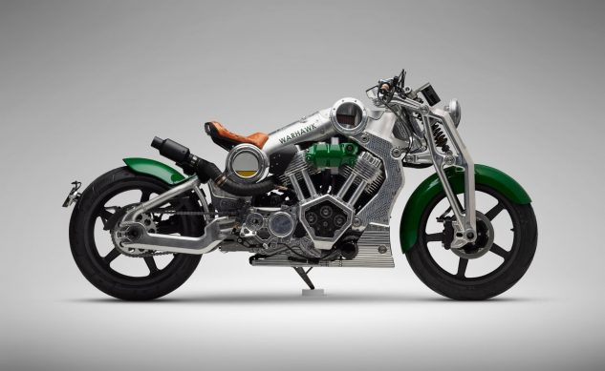
Updates, Open Forum, New Stuff

Slide 15
Texas Motorcycle Safety Coalition Quarterly Meeting
Adjourn

