Slide 1
Texas Motorcycle Safety Coalition Quarterly Meeting
June 24, 2021
10:00 am – 11:30 am

Slide 2
Agenda
10:00 – 10:05 Opening Remarks & Introduction (Chris B)
10:05 – 10:10 Webex refresher (Mike)
10:10 – 10:25 Forum Review and 2022 Plan (Cathy)
10:25 – 10:40 Task Force Activity Update (Cathy)
Task Force Membership Request (Cathy)
Task Force Legislative Update (Jude)
10:40 – 10:45 TDLR Update (Ford)
10:45 – 10:55 FHWA Report (Mike)
10:55 – 11:30 Updates, Open Forum (Chris B)
11:30 Adjourn (Chris B)

Slide 3
WebEx Refresher
Please stay muted (Jack will help with this)
This limits distracting sounds and noises that detract from the meeting. TTI will also be muting people.
Don’t put us on “hold”.
Participate in the meeting.
Use WebEx chat.
Or after the meeting, send us a note using the Contact Us page on looklearnlive.org.

Slide 4
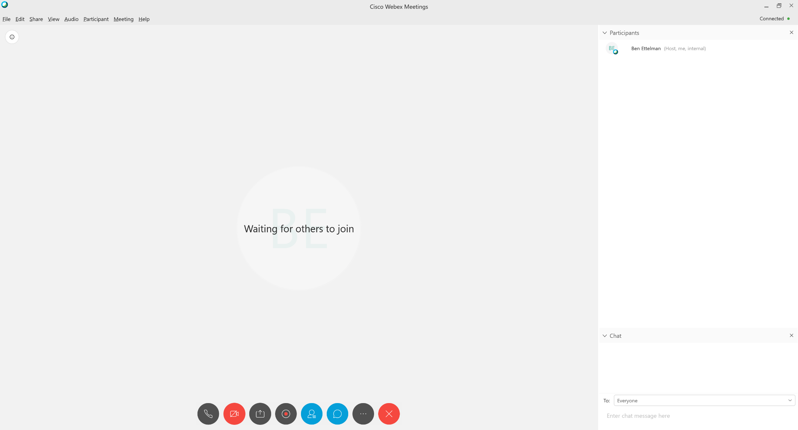
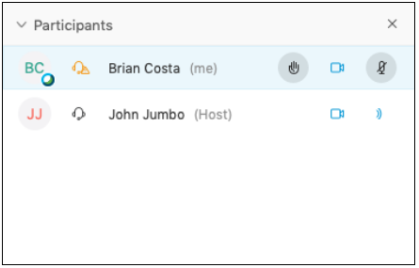
WebEx Refresher
2
Raise your hand
Chat will appear here
1
2
Click to open chat box
Enter text here then press return

Slide 5
2021 Forum - Attendance
Session | Attendance on May 1 (live) | Attendance May 1-17 (on-demand)
Welcome and Housekeeping | 51 | 14
Rider Behaviors that Increase Risk | 32 | 8
Increasing Rider Training and Licensing | 32 | 11
How you can Help Reduce Rider Crashes Through Effective Communication | 23 | 11
How to Educate Motorists about Rider Safety | 37 | 5
How Motorcyclists are Helped at the National Level | 28 | 6
How Can Clubs and Groups Improve Rider Safety | 30 | 7
Session Awards and Closing Comments | 44 | 2

Slide 6
2021 Forum in Review
“What are you hoping to get from the Motorcycle Safety Forum?”:
Riding tips and skills to reduce your risk of crashing: 88 (65%)
Information about motorcycle laws and legislation: 99 (73%)
Information about motorcycle crashes, injuries, and fatalities: 101 (74%)
Ways to promote motorcycle awareness to other drivers: 105 (77%)
New developments in motorcycle safety: 107 (79%)
Ideas for promoting motorcycle safety among riders: 113 (83%)

Slide 7
2021 Forum – Session Ratings, 1 (highest) to 5 (lowest)
Session | Session Content | Speaker Knowledge | Speaker Presentation | Usefulness to You
Welcome and Housekeeping | 1.2 | 1.1 | 1.1 | 1.3
Rider Behaviors that Increase Risk | 1.1 | 1.1 | 1.1 | 1.7
Increasing Rider Training and Licensing | 1.5 | 1.5 | 1.5 | 1.5
How you can Help Reduce Rider Crashes Through Effective Communication | 1.1 | 1.1 | 1.1 | 1.6
How to Educate Motorists about Rider Safety | 1.1 | 1.1 | 1.3 | 1.4
How Motorcyclists are Helped at the National Level | 1.3 | 1.1 | 1.4 | 1.3
How Can Clubs and Groups Improve Rider Safety | 1.4 | 1.3 | 1.4 | 1.4
Session Awards and Closing Comments | 1.1 | 1.0 | 1.0 | 1.2

Slide 8
2022 Forum Planning Feedback
When would you prefer to hold next year’s Motorcycle Safety Forum?

Slide 9
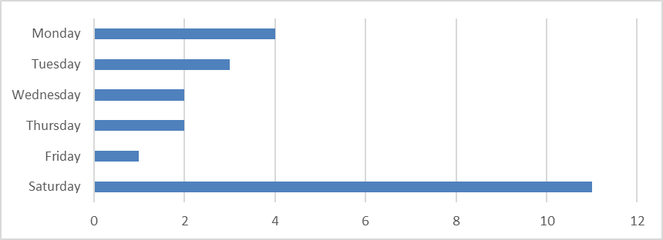
2022 Forum Planning Feedback
When would you prefer to hold next year’s Motorcycle Safety Forum?

Slide 10
2022 Forum Planning Feedback
Hold the Forum as an in-person event; but if possible, include a virtual attendance option for those who cannot attend in person.
Consider scheduling a pre- or post-Forum activity such as a ride or bike rodeo.
Include a focus on young riders and racing bikes in some presentations.
A variety of topics appeal to attendees; presentations about riding skills, technologies, and motorcycle-related legislation were the most popular among the topics proposed in the feedback survey.

Slide 11
2022 Forum Planning Ideas
Raise your hand
Type ideas into chat
Contact Us

Slide 12
TMSC Task Force - Overview
Purpose
To help the TMSC by focusing on key motorcycle safety issues and making recommendations back to TMSC members.
Meetings
The Task Force will be meeting quarterly (short and productive) or more frequently depending on work product and members’ availability.
JOIN US!
Interested? Notify Dr. Mike (m-manser@tti.tamu.edu)

Slide 13
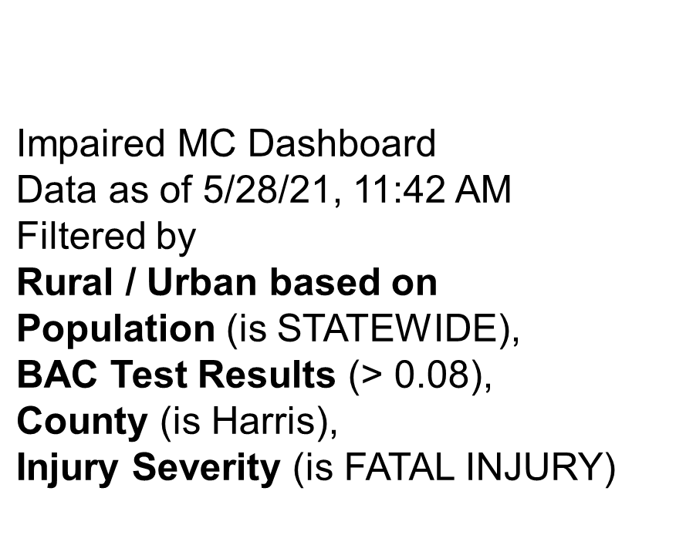
TMSC Task Force - Task One
Topic Focus: Rider Impairment
Data Review:
Notes:
TF decided to focus on impaired riding as it is one of the primary factors contributing to MC fatalities and suspected serious injuries. Now there is a need to examine the topic further to create a targeted campaign.
The TF is planning on a multi-year effort because of the enormity of the problem.

Slide 14
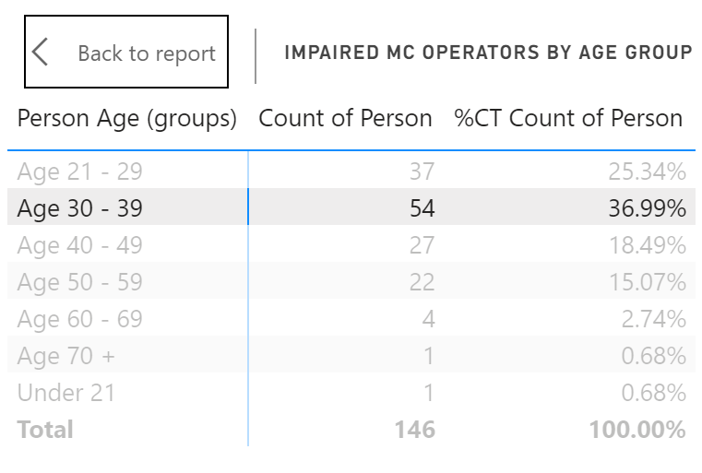
TMSC Task Force - Task One
Notes:
The TF has also contributed to planning the Forum by reviewing and commenting on sessions, speakers, agenda, etc.

Slide 15
TMSC Task Force - Task One
Topic Focus: Rider Impairment
Next Steps:
Develop survey to determine target behaviors and potential countermeasures
Develop campaign strategies and materials
Implement pilot
Notes:
TF decided to focus on impaired riding as it is one of the primary factors contributing to MC fatalities and suspected serious injuries. Now there is a need to examine the topic further to create a targeted campaign.
The TF is planning on a multi-year effort because of the enormity of the problem.

Slide 16
TMSC Task Force
Legislative Update

Slide 17
TDLR Update

Slide 18
FHWA Report Out
Search for: fhwa motorcycle barriers
or
https://safety.fhwa.dot.gov/motorcycles/docs/FHWA-SA-21-069_Addressing_MAC_Recommendations_Rpt.pdf

Slide 19
FHWA Report Out
Not yet available. Likely 1 – 2 months from now.
Coming up after that are Noteworthy Practices and then CAV

Slide 20
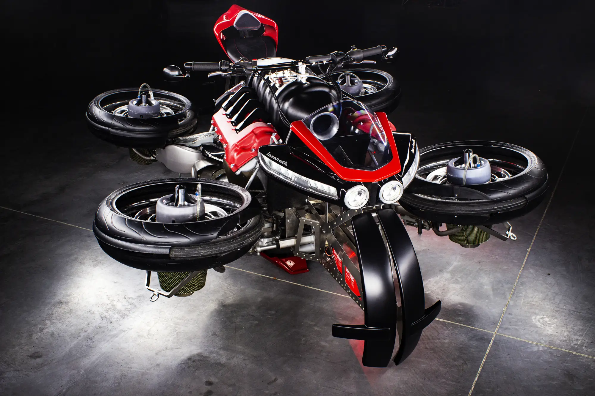
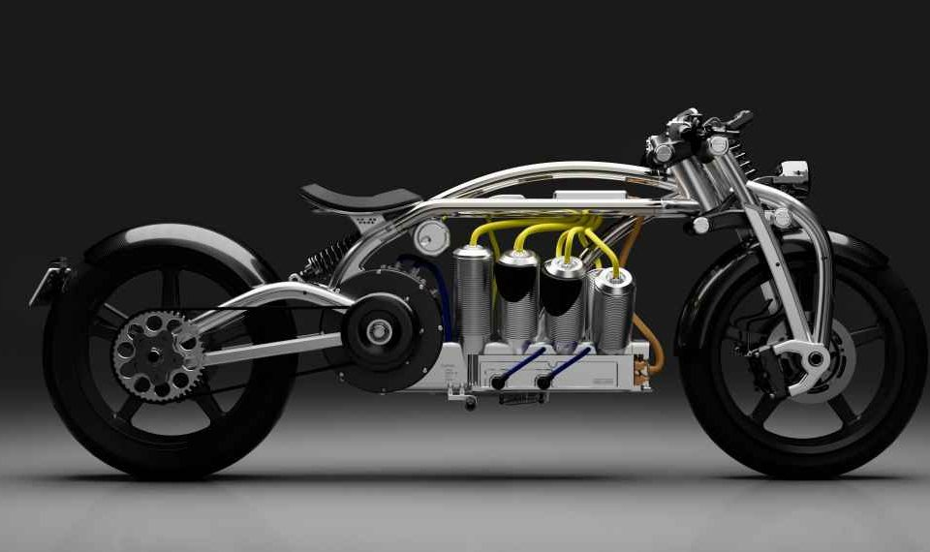
Updates, Open Forum, New Stuff

Slide 21
Pledge
#IRideForTomorrow
#TxMotorcycleSafetyPledge

Slide 22
TxDOT

Slide 23
Mark Your Calendar
TEXAS MOTORCYCLE SAFETY COALITION MEETING: SEPTEMBER 2, 2021
Webex Conference Call 10:00 am - 11:30 am

Slide 24
Texas Motorcycle Safety Coalition Quarterly Meeting
Adjourn

